Slide 1
Objectives
Menstruation
Hormone function
Fertilization/implantation
Placenta & structures
Fetal circulation
Nagele’s rule
Grief
Pregnancy
Presumptive
Probable
Positive
Physio changes
Adolescent
Danger signs
GTPAL

Slide 2
Structures for Conception
Female genitals
Pelvis
Uterus

Slide 3
Menstrual cycle
Menstrual
Proliferative
Secretory
Ischemic

Slide 4
Ovarian cycle
Follicle
Corpeus luteum

Slide 5
Pituitary cycle

Slide 6
MEASURING SPINNBARKEIT (ELASTICITY)

Slide 7
Factors Contributing to Genetic Disorders
1. Hereditary factors
Abnormalities passed from one or both parents.
2. Non-hereditary factors
Environmental
Infections or diseases
Advanced maternal age
Notes:
Text: Lowdermilk, pg 147
X-Linked Recessive disorders = carried on the “X” Chromosomes by the female
Males most affected because they only have one “X” vs females with XX
Examples: Hemophilia, color blindness and muscular dystrophy

Slide 8
Diagnostic Procedures
1. Ultrasound
2. Chorionic Villi sampling
3. Amniocentesis
Fluid analysis
4. Prenatal Labs
MSAFP
Triple Screening: MSAFP + estriol + hCG

Slide 9
AMNIOCENTESIS
CHORIONIC VILLI
SAMPLING

Slide 10
Nursing Management
1. Assessment: Genetic Hx
2. Nursing Dx:
Decisional Conflict
Anticipatory Grieving
Knowledge Deficit
Body Image Disturbance
3. Planning and Implementation:
Identify families needing counseling
Provide information
Support

Slide 11
5. Evaluation
Couples receive appropriate counseling
Families receive needed information and support
Families are comfortable with own decisions

Slide 12
FERTILIZATION AND IMPLANTATION
1. Fertilization
Ova
Sperm
2. Cellular Multiplication
3. Implantation
4.Cell differentiation
Notes:
Text: Lowdermilk, pg.150
Fertilization: union of egg and sperm in the outer 3rd of fallopian tube = Ampulla
a. Ovum nucleus and head of sperm fuse to combine chromosomes = 46 pairs
b. Mitotic replication called cleavage begins = zygote travels 3-4 days down fallopian tube to uterus
c. Egg divides = morula (solid ball of cells) protected by zona pellucida
d. On the journey = fluid passes thrugh the zona pellucida into the intercellular spaces of the egg and separates tissue = #1 trophoblasts = placental tissue….#2 embryoblast (embryo)
Implantation
a. Zona pellucida degenerates & trophoblast attaches to endometrium in the fundal region
b. Chorionic villi develp out of the trophoblasts and extend into the blood-filled spaces of the endometrium
c. The endometrium then becomes the decidua basalis
Cell Differentiation: occurs during the 3rd week after conception
a. Embryonic disk differentiates into 3 primary germ layers…all fetal tissue and organs develop from these layers.
b. Ectoderm = upper layer of embryonic disk = epidermis, glands, nails, hair, nervous system, lens of eye, tooth enamel, and floor of the amniotic cavity.
c. Mesoderm (middle) = bones, teeth, muscles, dermis, connective tissue, cardiovascular system, spleen and urogential system.
d. Endoderm (lower layer) = epithelium lining of the resp. tract and digestive tract, liver, pancreas, urethra, bladder, and vagina.

Slide 13
Ampulla
Ovulation
Prostaglandin
Fertilization

Slide 14
Embryonic membranes
Chorion
Amnion

Slide 15
MATERNAL SIDE OF PLACENTA
FETAL SIDE OF PLACENTA

Slide 16
PLACENTAL CIRCULATION

Slide 17
Functions of the Placenta
1. Transportation Unit
Oxygen and Carbon dioxide exchange
Waste exchange
Nutrient exchange
2. Endocrine
3. Immunologic

Slide 18
Umbilical Cord

Slide 19
Fetal Circulation
Respiratory system
Cardiovascular system

Slide 20
Fetal Development
4 weeks: fetal heart begins to beat .
8 weeks: all body organs are formed.
12 weeks: fetal heart tones heard by Doppler, placenta and fetal circulation complete.
16 weeks: sexual differentiation can be seen, looks like a baby.
20 weeks: Heart beat can be auscultated, lanugo covers body, fetal movements felt, fetus sucks, kicks and sleeps in cycles.

Slide 21
24 weeks: vernix present, fetal respiratory movements begin, weighs approx. 1 lb 10 oz.
28 weeks: skin is red, eyes begin to open and close, surfactant present
30-31 weeks: gaining subcutaneous fat, assumes birth position, and L/S
ratio 1.2 : 1
36 - 40 weeks: lanugo disappears, amniotic fluid decreases, and L/S
ration converts 2:1

Slide 22
Nageles Rule

Slide 23
PREGNANCY
3 TRIMESTERS: 10 Lunar Mo.
1st TRIMESTER = 1-13 WEEKS
2nd TRIMESTER = 14-26 WEEKS
3rd TRIMESTER = 27-TERM (38-40)

Slide 24
Signs and Symptoms
1. Presumptive or Subjective:
Amenorrhea
N&V
Urinary frequency
Breast tenderness and changes
Fatigue
Quickening

Slide 25
Signs and Symptoms
2. Probable or Objective:
Chadwick’s sign
Goodell’s sign
Hegar’s sign
Enlargement of abdomen
Uterine souffle
Pigmentation changes
Braxton Hicks contractions

Slide 26
Diagnostic- Positive Indicators
1. Fetal heartbeat
2. Fetal movements palpated
3. Ultrasound
4. Detection of placental hormones

Slide 27
ADOLESCENT MOTHERS
1 Million Teenagers are
pregnant each year.
30% of these pregnancies end
in abortion.
500,000 deliver each year.
1 in 6 teenagers will become
pregnant again in one year.

Slide 28
Adolescent’s Normal Growth & Development
Age range: 12 to 18 or 20 years old.
Time of rapid physical growth, cognitive,
social, and emotional maturity.
Time of sexual maturity.

Slide 29
Dilemmas for the Pregnant Adolescent
1. Psychological Maturity:
Parenthood v.s. Adolescent Growth and Development.
Ability to make choices and decisions.
Ability to understand consequences of child-bearing and child rearing.
Ability to make a life long commitment.

Slide 30
Dilemmas for the Pregnant Adolescent
2. Physiological Maturity:
Cardiovascular system still maturing.
Respiratory and basal metabolic
systems maturing.
Skeletal system continues
to mature

Slide 31
Adolescent Behavior verses Older Women
1. Less likely to receive adequate prenatal care.
2. More likely to smoke.
3. More likely to use drugs.
4. More likely to be malnourished and not gain weight.
THEREFORE:
1. Prone to high risk….hypertension.
2. Prone to deliver low birth weight babies.
3. Prone to have long-term disabilities.

Slide 32
Physiologic Changes
1. Reproductive system
Uterine enlargement
Braxton Hicks contractions
Cervical
Ovarian
Vagina
Breasts

Slide 33
Physiologic Changes
2. Cardiovascular System
Blood volume increases 40% to 45%
Red blood cell volume increases 17%
Hematocrit decreases 7% (physiologic anemia of pregnancy)
Pulse increases
BP decreases slightly and returns to near normal during third trimester
Dependent edema
Supine and postural hypotension

Slide 34
Physiologic Changes
3. Respiratory System
Diaphragm elevates.
Nasal edema and vascular congestion.
Rate and vital capacity increase.
Airway resistance decreases allowing 15% to 20% increase in oxygen uptake.

Slide 35
Physiologic Changes
4. Gastrointestinal System
N&V during first trimester.
Gum tissue soft and bleeds easily.
Increased saliva (ptyalism).
Gastric acidity decreases.
Gastric emptying time decreases.
Cardiac sphincter relaxes.
Decreased intestinal motility.
Pressure on vessels from enlarging
uterus .

Slide 36
Physiologic Changes
5. Urinary System
Output increases, specific gravity decreases.
Urinary frequency during 1st and 3rd trimesters.
Glomerular filtration rate rises by 50%.
Renal tubular absorption increases.
Glycosuria is common.

Slide 37
Physiologic Changes
6. Integumentary System
Linea nigra and Chloasma.
Vascular spider nevi.
Areola and nipple color changes.
Striae on abdomen, breasts and thighs.
Increased activity of sweat and sebacious glands.

Slide 38
Physiologic Changes
7. Skeletal System
Sacroiliac, sacrococcygeal and pubic joints relax.
Symphysis pubis may separate slightly.
Lumbodorsal spinal curve increases.
Diastasis recti.

Slide 39
PHYSIOLOGIC CHANGES 8. Metabolic Changes - Weight Gain
1. First Trimester:
2 to 5 lbs
2. Second Trimester:
12 to 15 lbs
3. Third Trimester:
12 to 15 lbs
Total = 24 to 30 lbs
Fetus 7.5 lbs
Placenta and
membranes 1.5 lbs
Amniotic fluid 2.0 lbs
Uterus 2.5 lbs
Breasts 3.0 lbs
Increased blood
volume 2-4 lbs
Extravascular
fluid and fat 4-9 lbs

Slide 40
PHYSIOLOGIC CHANGES
9. Endocrine System Changes
Thyroid: increase in basal metabolic rate
Pituitary: Prolactin and Oxytocin
Pancreas
Adrenals: Cortisol and Aldosterone
Placental Hormones: HCG, estrogen, progesterone, human placental lactogen, relaxin
Parathyroid

Slide 41
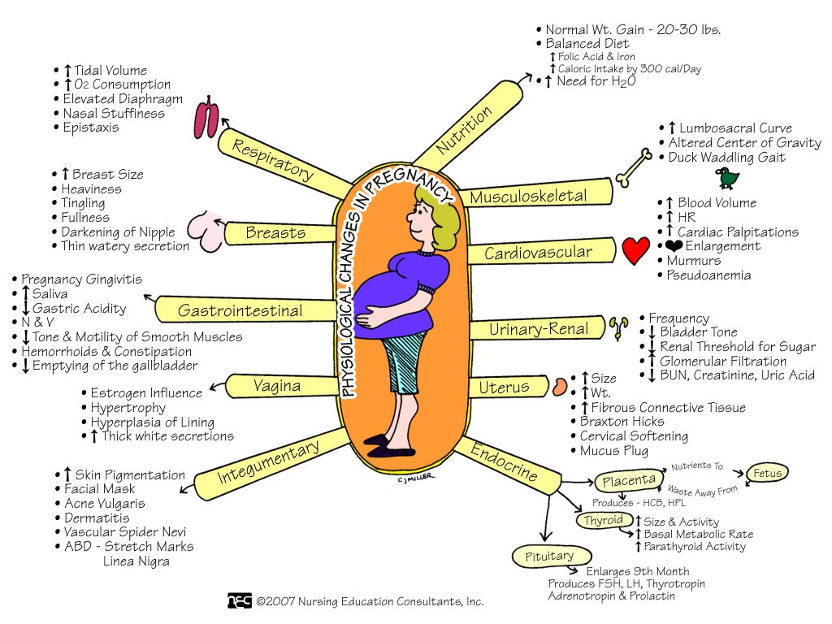

Slide 42
Minor Discomforts of Pregnancy First Trimester
N&V
Nasal stuffiness
Urinary frequency
Breast tenderness
Ptyalism
Leukorrhea
Headaches
Fatigue

Slide 43
Minor Discomforts of Pregnancy Second Trimester
Heartburn
Pruritus
Varicose veins
Hemorrhoids
Constipation
Carpal tunnel syndrome
Leg cramps
Faintness
Difficulty sleeping
Round ligament pain & Backache

Slide 44
Minor Discomforts of Pregnancy Third Trimester
Ankle edema
SOB
Hemorrhoids
Difficulty sleeping
Perineal pressure
Braxton Hicks contractions

Slide 45
Danger Signs of Pregnancy
1. Sudden gush of fluid from vagina
2. Vaginal bleeding
3. Abdominal pain
4. Temperature above 101 F or 38.3 C
5. Dizziness, blurring of vision, double
vision, spots
6. Persistent vomiting
7. Severe headache
8. Edema of hands, face
9. Muscular irritability, convulsions
10. Epigastric pain
11. Oliguria or Dysuria
12. Absence of fetal movement

Slide 46
Nutrition in Pregnancy
INCREASE CALORIES
BY 300
INCREASE PROTEIN TO
60 g (+14 g)
<30%
FATS
(1 c.)
(2 oz)
2-3
2-3
INCREASE TO 4
MEAT
POULTRY
INCREASE TO 3
MILK
(1/2 - 1 c)
3-5
2-4
(1/2 - 1c)
VEGIES
FRUIT
INCREASE
FOLIC ACID
AND IRON
INCREASE CA
TO 1300/1000 MG
6-11
GRAINS
(1 slice, 3/4 c dry cereal, 1/2 c rice)

Slide 47
Nutrition in Pregnancy
Commonly recommended nutritional supplements contain: vitamins B₆, D, E, C, folic acid, pantothenic acid, iron, calcium, magnesium, zinc and copper.
Sources of iron: molasses, legumes, dried fruits, eggs, lean meat, dark green leafy vegetables, shellfish.
Sources of calcium: dairy products, beans, leafy green vegetables.
Sources of folic acid: liver, peanuts, yeast, green leafy vegetables

Slide 48
Frequency of Prenatal Visits in Normal Pregnancy
1. Every four weeks for the first 28 weeks of gestation.
2. Every two weeks to week 36.
3. After week 36, weekly until delivery.
4. Post delivery – vary.

Slide 49
Antepartum Assessment
1. Current history.
2. Cultural issues and practices .
3. Maternal weight gain.
4. Uterine growth.
5. Fetal activity & Fetal heart rate.
6. Nageles Rule: Last menstrual period.
7. Quickening.
8. McDonald’s fundal measurement .

Slide 50
McDonald’s Method of fundal measurement

Slide 51
Antepartum Assessment
9. Obstetrical History
Previous pregnancies: G T P A L
G = gravida of uterus.
T = term pregnancy after 37 weeks.
P = preterm infant after 20 weeks.
before 37 weeks.
A = abortion
L = number of living children.

Slide 52
Antepartum Assessment
10. Prenatal Lab Tests & Procedures
CBC, Hemoglobin, Blood type, Rh
Rubella titer
Sexually transmitted diseases
3 hour glucose tolerance
Triple Marker or MSAFP
Ultrasound
Amniocentesis
Choronic Villi Sampling

Slide 53
Conceptual Model of Grief
Stage 1….Acute Grief
State of shock and numbness
State of confusion, disbelief, and denial.
Exhibit intense outbursts emotions and crying.

Slide 54
Conceptual Model of Grief
Stage 2…Intense Grief
Encompasses a variety of different emotional feelings.
Intense guilt emerges from deep feelings of helplessness.
Anger, resentment, bitterness, or irritability emerge.
Fear and anxiety occur.
Deep sadness and depression occurs.
Physical symptoms begin to appear.

Slide 55
Conceptual Model of Grief
Stage 3….Reorganization
Time when parents begin to understand “Why.”
Occurs when parents are able to function better at
home, work, and experience a return of self-esteem.
Can better cope with new challenges and has put
the loss in perspective.
Able to enjoy simple pleasures without feeling guilty.

Slide 56
Anticipatory Grieving
The process through which an individual
experiences reactions in response to an expected, anticipated or possible significant loss:
PROM
PTL
Infertility issues.

Slide 57
Nursing Interventions
1. Listening without trying to offer explanations.
2. Allow to see and hold infant.
3. Photo, footprints, etc.
4. Keep comfortable without sedating.
5. Allow patient as much control as possible.
6. Remember she is still a postpartum patient

Slide 58
Documentation
1. Checklists are used to provide continuity of care
and recording keeping for documentation.
2. Medical Record such include:
Primary concerns of the parents/family
Grief responses
Teaching and referrals
Health care given
Funeral arrangements, disposition of the body.
Completion of death certificate & type of death.

