Slide 1
Acute Respiratory
Part 1
Notes:
Part 1:
Today upper airway
Vent fail
ABG
Part 2:
Infection
ARDS
Vents

Slide 2
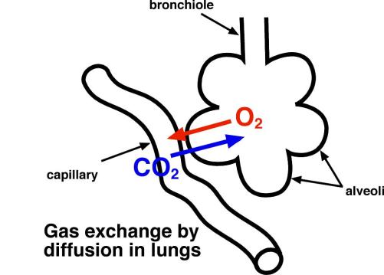
Respiratory system: Functions
Oxygen transport
Respiration
External
Internal
Notes:
Resp system provides for oxygen and CO2 removal
Largely dependent on surface area of alveoli
External-blow off CO2
Internal-diffusion into bloodstream

Slide 3
Notes:
Diagram illustrating respiration and pressure gradient to allow diffusion

Slide 4
Respiratory system: Functions
Ventilation
Air Pressure Variances
Airway Resistance
Compliance
Surfactant
Notes:
Ventilation-air moving in and out
Variances in air pressure are related to atmospheric pressure (p490 12ed)
Resistance determined by size of airway
Any pathology that affects bronchial size affects resistance
Compliance-ease of expansion and elasticity
Surfactant allows more compliance (decreases surface tension)
Imagine making a pizza and you don’t oil your hands first-you get a sticky mess
Oil your hands and the dough doesn’t stick to your hands
CLICK for pic

Slide 5
Notes:
Illustration of ventilation

Slide 6
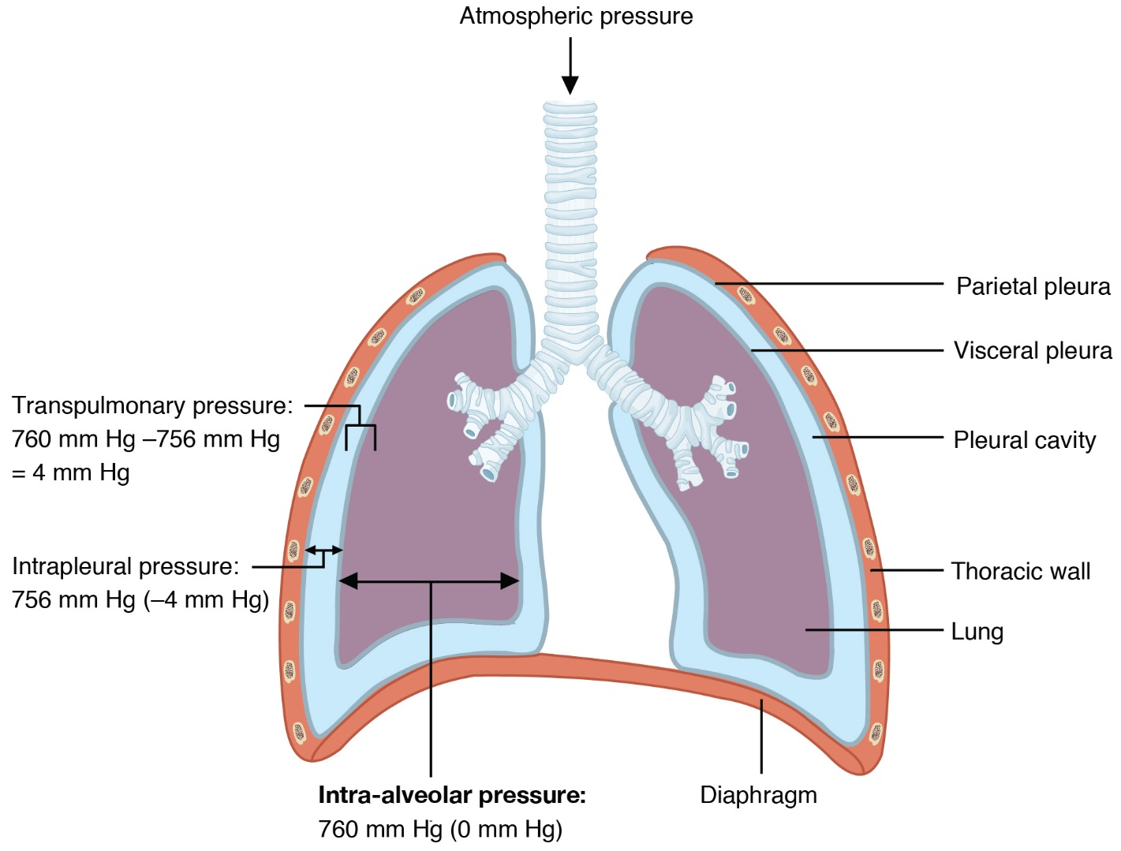
Respiratory system: Ventilation
Airway Pressure
Intra-pleural pressure
Intra-thoracic pressure
Intra-alveolar
Notes:
The pressures vary depending on each of these areas, not going into detail here
STUDENTS HAVE DEFINITIONS OF EACH
CLICK for pic

Slide 7
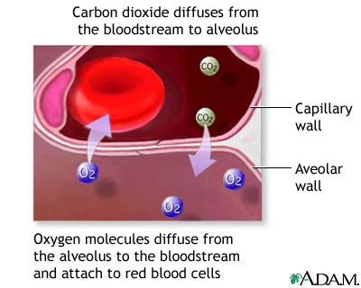
Respiratory system: Functions
Diffusion
Perfusion
Ventilation/Perfusion (VQ ratio)
Notes:
Diffusion-exchange oxygen and CO2
Pulm Perfusion- blood flow through pulm circulation from R heart to L heart
Perfusion-many factors: alveolar pressure high-capillaries squeezed and sometimes collapse, PA is high difficult to get blood to lungs
Pulm press usually low-PA press 20-30/5-15 (compared to normal systemic BP)
When a person is upright, PA pressure not enough to perfuse the apex of lung
-upper with poor supply, lower with max supply, middle mod supply
Turning a patient, more blood to the dependent lung

Slide 8
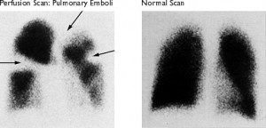
Respiratory system: V/Q Imbalance
V=Q Normal
Ventilation=perfusion
V>Q Dead space
PE, cardiogenic shock
Q>V Shunting
Obstruction, PNA, mucous plug, atelectasis
No V/Q Silent unit
PNA, ARDS
Notes:
V ventilation
Q perfusion
A V/Q imbalance results in shunting of blood and lack of perfusion to certain areas=hypoxia
Blockages, compliance and gravity alter ventilation
4 possible states
Normal-an equal amount of blood passes the alveolus with an equal amount of gas
High VQ ratio-dead space, ventilation exceeds perfusion, the alveoli don’t have enough blood supply for gas exchange
-PE, cardiogenic shock
Low VQ ratio-shunting-perfusion exceeds ventilation, blood bypasses the alveoli without exchanging gas
-obstruction of distal airways, PNA, atelectasis, tumor, mucus plug
Silent unit-absence or limited ventilation or perfusion, pneumo or ARDS
CLICK for PE xray

Slide 9
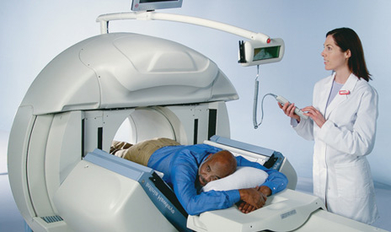
Notes:
VQ scanner
Must lie flat for 30-40 minutes
Using more CT scan then VQ scan

Slide 10
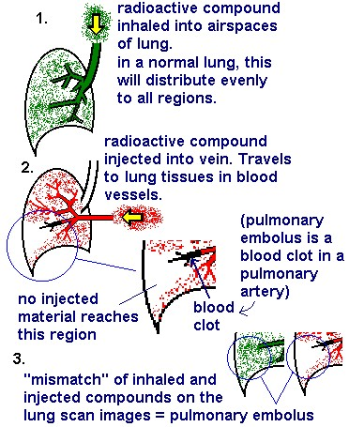
Notes:
Go over chart

Slide 11
Notes:
I can’t hold my breath much longer!

Slide 12
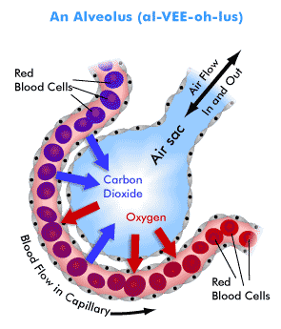
Respiratory system: Complications V/Q
Organ hypoxia affects all body systems
Ventilatory failure more serious
Acute Respiratory Acidosis
Impaired cellular function
Notes:
If we have a VQ mismatch:
Organ hypoxia affects all body systems
Ventilatory failure more serious
Acute Respiratory Acidosis
Impaired cellular function

Slide 13
Respiratory failure
Sudden, life threatening deterioration gas exchange
Exchange O₂ & CO₂ cannot keep up with demand
PaO₂ <50mm hg hypoxemia
PaCO₂>50 Hypercapnia
pH <7.35
Notes:
Respiratory failure=sudden life threatening
Cant keep up with O2 CO2 balance
PaO₂ <50mm hg hypoxemia
PaCO₂>50 Hypercapnia
pH <7.35

Slide 14
Respiratory failure: Pathogenesis
Interferes with the V/Q relationship
Increased O₂ demands
Progressive increase CO₂, decrease O₂
Work of breathing increases
Notes:
Remember respiration is exchange
Typo on student version-decrease O2 not CO2
Interferes with the V/Q relationship
Increased O₂ demands
Progressive increase CO₂, decrease O₂
Work of breathing increases=muscle fatigue

Slide 15
Respiratory failure: 4 Causes
Decreased respiratory drive
Dysfunction in chest wall
Dysfunction of lung parenchyma
Complication of major thoracic surgery
Notes:
Causes
Decreased respiratory drive
Dysfunction in chest wall
Dysfunction of lung parenchyma
Complication of major thoracic/abd surgery

Slide 16
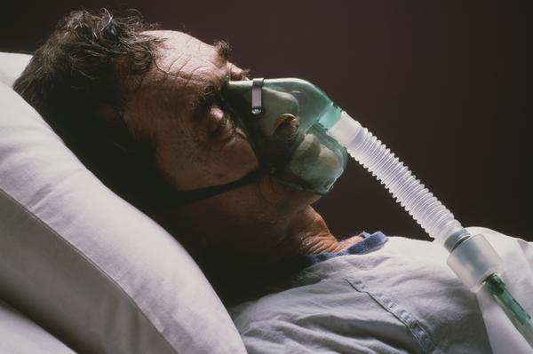
Respiratory failure: S/S
Dyspnea/tachypnea
Restlessness
Cyanosis
Dysrhythmias
ALOC
Notes:
Dyspnea/tachypnea
Restlessness
Cyanosis
Dysrhythmias
ALOC

Slide 17
Ventilation failure
Can’t move air adequately in/out
Increased CO₂
Causes
Neuromuscular disorders
Respiratory muscle fatigue
COPD
Acute respiratory acidosis
PaCO₂ >50, pH <7.3
Notes:
Remember ventilation is air flow
Ventilation failure
Can’t move air adequately in/out
Increased CO₂
Causes
Neuromuscular disorders
Respiratory muscle fatigue
COPD
Acute respiratory acidosis
PaCO₂ >50, pH <7.3

Slide 18
Oxygenation failure
Impaired diffusion across membrane
Causes:
ARDS
PE
Acute asthma attack
Pneumonia
Hypoxemia (PaO₂ <60 on room air)
PaO₂ >80 normal
PaO₂ <80 mild
PaO₂ <60 moderate
PaO₂ <40 severe
Notes:
Impaired diffusion across membrane
Causes:
ARDS
PE
Acute asthma attack
Pneumonia
Hypoxemia (PaO₂ <60 on room air)
PaO₂ >80 normal
PaO₂ <80 mild
PaO₂ <60 moderate
PaO₂ <40 severe

Slide 19
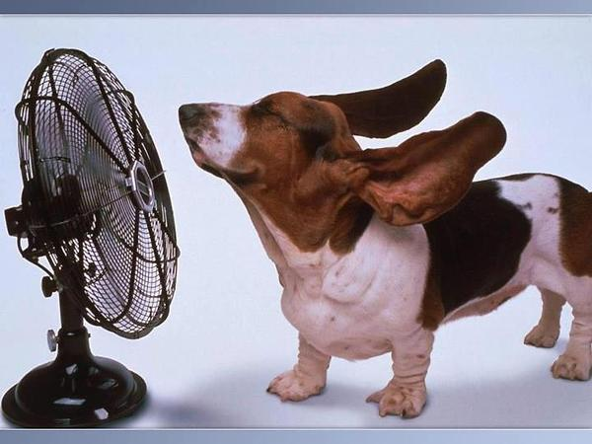
Pause Point

Slide 20
A VQ scan is commonly performed to diagnose a PE. This test provides what type of information?
A. Amount of perfusion present in the lung.
B. Extent of the occlusion and amount of perfusion lost.
C. Location of the pulmonary embolism.
D. Location and size of the pulmonary embolism.
Notes:
B

Slide 21
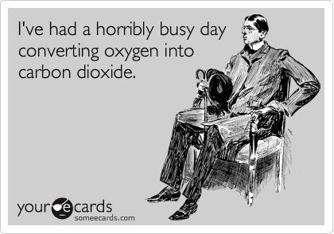

Slide 22
Indicate:
Acid-base balance
Oxygenation status
Ventilation status
Normal ABG
pH 7.35-7.45
PaO₂ 80-100 mmHg
PaCO₂ 35-45 mmHg
HCO₃ 22-26
Base Excess +2 to -2
O₂ Sat 95-100%
ABGs
Notes:
Students have a table (alternate method) on next slide

Slide 23
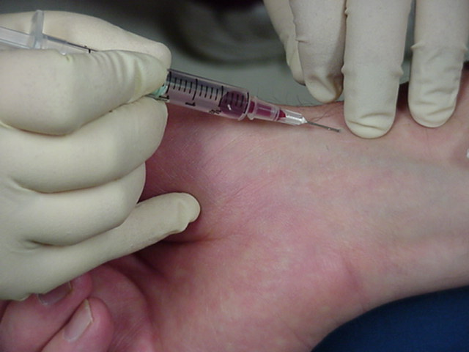
Radial Artery
Flashback
Notes:
Obtaining an ABG sample, RT

Slide 24
ABG analysis
pH: acid or alkaline?
CO₂ & HCO₃: acid or alkaline?
Let’s Practice!
Notes:
STUDENTS DON’T HAVE-their slide is slightly different
pH: acid or alkaline?
CO2 & Bicarb: acid or alkaline?
Let’s Practice!
These are from the syllabus

Slide 25
ABG Practice
pH 7.50
PaCO₂ 28 mmHG
PaO₂ 48
SaO₂ 77%
HCO₃ 24 mEq/L

Slide 26
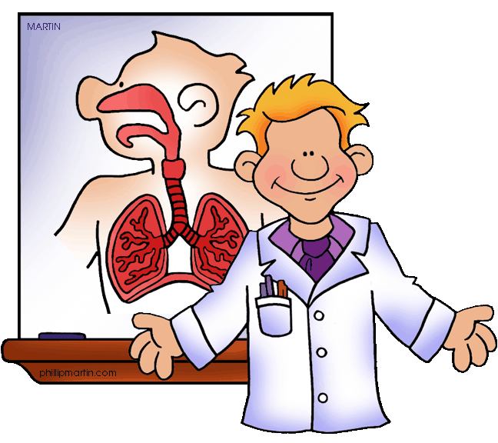
Results
A. Metabolic Acidosis
B. Metabolic Alkalosis
C. Respiratory Acidosis
D. Respiratory Alkalosis
Notes:
D Resp Alk

Slide 27
ABG Practice
pH 7.50 Alk
PaCO₂ 28 mmHG Alk
PaO₂ 48 Hypoxic
SaO₂ 77%
HCO₃ 24 mEq/L Norm
Notes:
Respiratory alkalosis
Causes?
Caused by respiratory
Hyperventilation-anxiety, pain
Resp stimulation from drugs
Gram neg bacteremia
PE

Slide 28
ABG Practice
pH 7.55
PaCO₂ 50
PaO₂ 90
SaO₂ 95%
HCO₃ 40

Slide 29
Results
A. Metabolic Acidosis
B. Metabolic Alkalosis
C. Respiratory Acidosis
D. Respiratory Alkalosis
Notes:
B Met Alk

Slide 30
ABG Practice
pH 7.55 Alk
PaCO₂ 50 Acid
PaO₂ 90 Norm
SaO₂ 95%
HCO₃ 40 Alk
Notes:
Metabolic alkalosis
Causes?
Bicarb depletion from diarrhea
Excessive production of acid from shock, endocrine disorders, drug intoxication
Renal disease

Slide 31
Notes:
Dude, you should definitely come to this pool party.
There are 2 hydrogens for every oxygen out there!

Slide 32
ABG Practice
pH 7.30
PaCO₂ 62
PaO₂ 48
SaO₂ 80%
HCO₃ 30

Slide 33
Results
A. Metabolic Acidosis
B. Metabolic Alkalosis
C. Respiratory Acidosis
D. Respiratory Alkalosis
Notes:
C compensating Resp Acid

Slide 34
ABG Practice
pH 7.30 Acid
PaCO₂ 62 Acid
PaO₂ 48 Hypoxic
SaO₂ 80%
HCO₃ 30 Alk
Notes:
Resp acidosis
Causes?
CNS depression
Resp arrest
Hypoventilation

Slide 35
ABG Practice
pH 7.32
PaCO₂ 47
PaO₂ 68
SaO₂ 91%
HCO₃ 25

Slide 36
Results
A. Metabolic Acidosis
B. Metabolic Alkalosis
C. Respiratory Acidosis
D. Respiratory Alkalosis
Notes:
C Resp Acid

Slide 37
ABG Practice
pH 7.32 Acid
PaCO₂ 47 Acid
PaO₂ 68 Hypoxic
SaO₂ 91% Dec Hgb?
HCO₃ 25 Norm
Notes:
Resp acidosis

Slide 38
ABG Practice
pH 7.37
PaCO₂ 49
PaO₂ 90
SaO₂ 95%
HCO₃ 32

Slide 39
Results
A. Metabolic Acidosis
B. Metabolic Alkalosis
C. Respiratory Acidosis
D. Respiratory Alkalosis
Notes:
C fully compensated Resp Acid

Slide 40
ABG Practice
pH 7.37 Norm (acid)
PaCO₂ 49 Acid
PaO₂ 90 Norm
SaO₂ 95% Norm
HCO₃ 32 Alk
Notes:
Resp acidosis

Slide 41
Notes:
Lets do a case study-if time
Stop here Pick up next time

Slide 42
Notes:
Play music
Props: (set out with a numbered card for each, can you identify?)

Slide 43
Acute respiratory
Part 2
Notes:
Part 2:
Infection
ARDS
Vents

Slide 44
Upper airway infections
Rhinitis
Pathophysiology
S/S
Medical Mgt
Nursing Mgt
Viral Rhinitis
Pathophysiology
S/S
Medical Mgt
Nursing Mgt
Notes:
NO NOTES
Rhinitis-inflammation/irritation mucous membranes nose,
acute, chronic, allergic, non allergic
Pathophysiology-allergy, change temp, OTC nasal decongestants, drug induced-ACE, Beta Blockers, Statins, antidepressants, ASA
S/S-runny nose, nasal congestion, sneezing, itching, HA
Medical Mgt- depends on cause, symptom mgt (antihistamine, corticosteroid sprays)
Nursing Mgt-education, avoid irritants, hand hygeine
Viral Rhinitis (common cold)
Pathophysiology-acute inflammation of mucous membranes
S/S-low grade fever, nasal congestion, halitosis, sneezing, scratchy sore throat, malaise, chills, HA, muscle ache
Medical Mgt-treat symptoms- fluids, rest, NSAIDS, salt water gargle, antihistamine
Nursing Mgt-teaching handwashing, using tissues, sneezing into arm

Slide 45
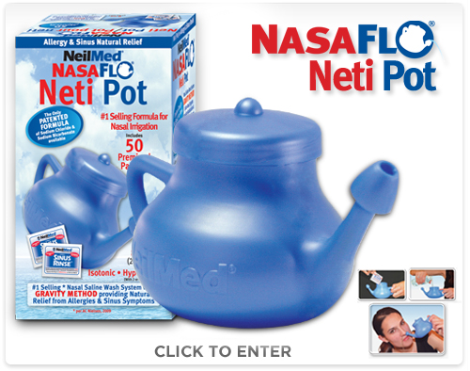
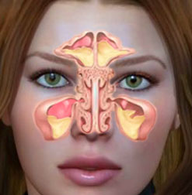
Upper airway infections
Sinusitis
Pathophysiology
S/S
Medical Mgt
Nursing Mgt
Notes:
NO NOTES
Sinusitis-bacterial or viral
Pathophysiology-usually follows a viral URI or cold-can’t clear mucous and it stays in sinus cavities
S/S-nasal drainage, pain, pressure
Medical Mgt-bacterial-abx, saline lavage, decongestant
Nursing Mgt-teaching, hand washing, NSAIDS, saline lavage

Slide 46
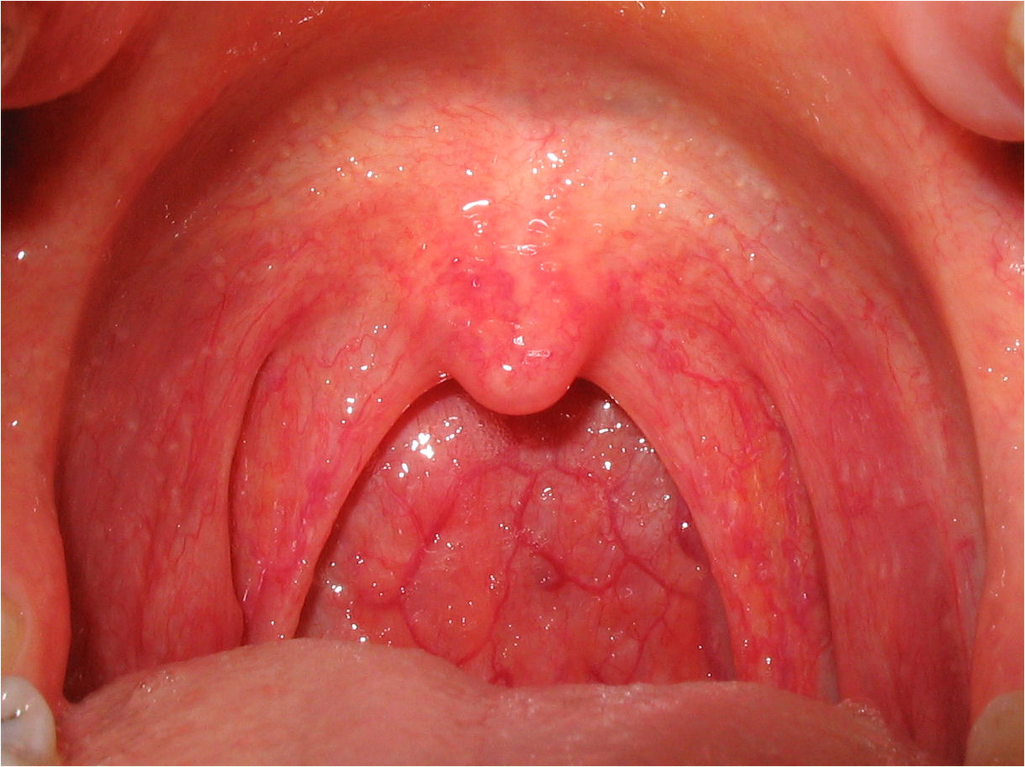
Upper airway infections
Pharyngitis
Pathophysiology
S/S
Medical Mgt
Nursing Mgt
Notes:
NO NOTES
Pharyngitis-sore throat-inflammation
Pathophysiology-viral infection usually, can be bacterial
S/S-fiery red pharyngeal membrane and tonsils, swollen lymph nodes
Medical Mgt-bacterial abx (PCN), supportive care, ASA, Tylenol, salt water gargles
Nursing Mgt-symptoms, hand washing

Slide 47
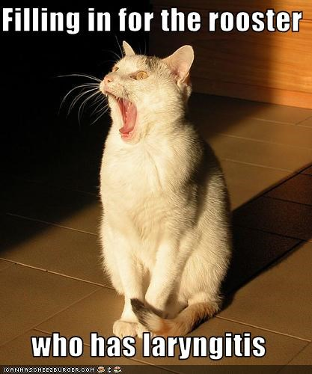
Upper airway infections
Laryngitis
Pathophysiology
S/S
Medical Mgt
Nursing Mgt
Notes:
Laryngitis-inflammation of the larynx
Pathophysiology-voice abuse or environmental exposure (verbal vomit)
S/S-hoarseness, loss of voice, severe cough
Medical Mgt- resting voice, avoiding irritants, eliminating infection
Nursing Mgt-education-humidifier, rest, fluids

Slide 48
Nursing Process: Planning
Maintain patent airway
Relieve pain
Effective communication
Hydration
Knowledge to prevent upper airway infection
No complications
Notes:
Maintain patent airway
Relieve pain
Effective communication
Hydration
Knowledge to prevent upper airway infection
No complications

Slide 49
Nursing process: Interventions
Maintain patent airway
Promote comfort
Analgesics
Gargles for sore throat
Hot packs sinus congestion
Ice to reduce swelling/bleeding post tonsillectomy/adenoidectomy
Rest
Refrain from speaking-alternate communication
Encourage liquids/appropriate foods
Notes:
Maintain patent airway
Promote comfort
Analgesics
Gargles for sore throat
Hot packs sinus congestion
Ice to reduce swelling/bleeding post tonsillectomy/adenoidectomy
Rest
Refrain from speaking-alternate communication
Encourage liquids/appropriate foods

Slide 50
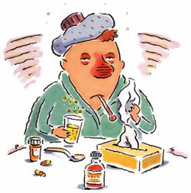
Patient education
Prevention of upper airway infection
Emphasize frequent hand-washing
When to call MD
Complete antibiotics
Annual flu vaccine
Notes:
Prevention of upper airway infection
Emphasize frequent hand-washing
When to call MD
Complete antibiotics
Annual flu vaccine

Slide 51
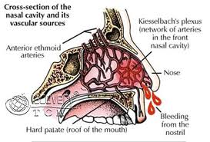
Upper airway obstruction/trauma
Epistaxis
Risk factors-chart 22-5, p534
Management-
Notes:
NO NOTES
Epistaxis nose bleed
Risks-HTN, infection, dry membranes, tumor, ASA
Mgmt- lean forward and pinch bridge (prevent aspiration)
phenylephrine-vasoconstrictor, tampon insertion, catheter with balloon

Slide 52
Upper airway obstruction/trauma
Nasal obstruction
Management
Fracture of nose
Management
Notes:
NO NOTES
Nasal obstruction
May lead to infection
Removal of obstruction
CLICK
Fracture of nose
Pain, bleeding, swelling, better if fixed in first 3 hours
Ice, decongestant, monitor hematoma, airway obstruction

Slide 53
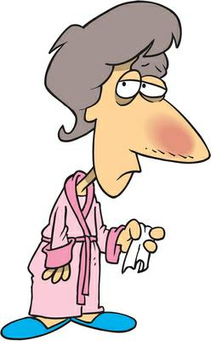
Chest and lower airway infection
Acute tracheobronchitis
Pneumonia
Community-acquired (CAP)
Hospital-acquired (HAP)
Pneumocystis jirovecii (PCP)
Aspiration

Slide 54
Core measures: Pneumonia (PNA)
Oxygen assess
Pneumococcal screening/vaccination
Blood culture prior to 1st antibiotic
Smoking cessation
Antibiotic within 4-8 hours of arrival
Immunocompetent patients within first 24 hours
Flu vaccine
Notes:
PN-1: Oxygen assess
PN-2: Pneumococcal screening/vaccination
PN-3: Blood culture within 24 hours and prior to 1st antibiotic
PN-4: Smoking cessation
PN-5: Antibiotic within 4-8 hours of arival
PN-6: Immunocompetent patients within first 24 hours
PN-7: Flu vaccine

Slide 55
Medical treatment: PNA
Supportive treatment
Fluids, O2, antipyretics, antitussives, decongestant, antihistamine
Administration antibiotics based on gram stain
Empiric antibiotic therapy
Antibiotics only for bacterial infection
Notes:
Supportive treatment
Fluids, O2, antipyretics, antitussives, decongestant, antihistamine
Administration antibiotics based on gram stain
Empiric antibiotic therapy-if unknown organism
Antibiotics only for bacterial infection

Slide 56
Nursing process: Assessment PNA
Changes in temp/pulse
Secretions
Cough
SOB
Inspection/auscultation of chest
Changes in CXR
Changes in mental status, fatigue, dehydration, concomitant heart failure, esp. elderly

Slide 57
Nursing process: Interventions
Improving airway clearance
Hydration
Humidified oxygen
Coughing techniques
Chest physiotherapy
Position changes

Slide 58
Pause Point

Slide 59
A 79 year old patient is admitted with pneumonia. Which nursing diagnosis should take priority?
A. Acute pain r/t lung expansion secondary to lung infection.
B. Risk for imbalanced fluid volume r/t increased insensible fluid losses secondary to fever.
C. Anxiety r/t dyspnea and chest pain.
D. Ineffective airway clearance r/t retained secretions.
Notes:
D

Slide 60
Pleural conditions
Pleurisy
Inflammation of both layers of pleura
Pleural effusion
Collection of fluid in pleural space
Secondary to other disease process
Empyema
Accumulation of thick, purulent fluid in pleural space

Slide 61
Pulmonary HTN
Conditions inc. risk
Vascular injury
Disease progression inc. blood flow
PA pressure & PV resistance inc
RV hypertrophy & failure
Notes:
They have same chart, different look

Slide 62
Pulmonary HTN
Types
Idiopathic (primary)
Unknown cause
Clinical manifestations
Hypoxemia
Signs of right heart failure
Tall peaked P waves (inferior leads)

Slide 63
Pulmonary HTN
Treatment
Oxygen
Fluid limit
Diuretics
Cardiac glycosides
Calcium channel blockers
Prostaglandin (Prostacyclin)
Anticoagulants

Slide 64
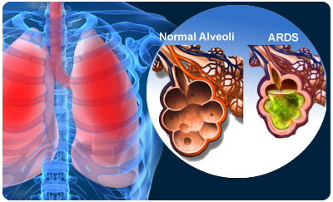
ARDS
Severe lung injury
Sudden progressive
pulmonary edema
increasing lung infiltrates
refractory hypoxemia
decreased lung compliance
Symptoms
Rapid onset severe dyspnea
Hypoxemia not respond to oxygen
Notes:
ARDS is a non cardiac pulmonary edema
CLICK for pic

Slide 65
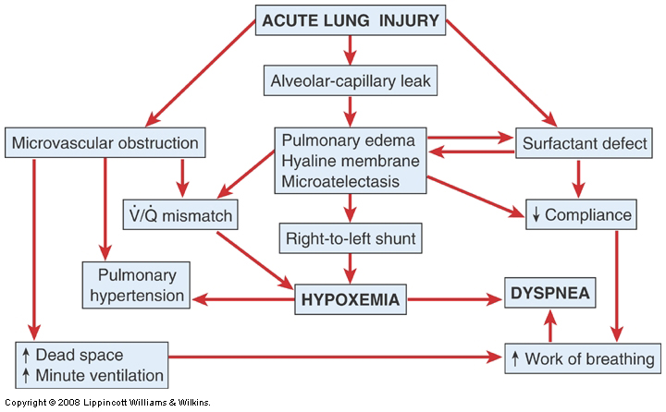
Pathophysiology ARDS
Figure 23-5
Notes:
Fig 23-6
NO NOTES
Injury reduces normal blood flow to lungs
Inflammatory response-platelets aggregate, histamine, bradykinin, serotonin released
Released substances damage capillaries- inc permeability, fluids move to tissue
Permeability worsens, proteins and fluids leak out, pulmonary edema
Dec blood flow and fluids damage surfactant, alveoli collapse, impaired gas exchange
Oxygenation impaired, CO2 crosses easily-oxygen and CO2 low
Pulm edema worsens and inflammation leads to fibrosis

Slide 67
Clinical manifestations ARDS
Clear to Crackles to Wheezes
Tidal volume decreases
Increasing restlessness
Dyspnea/tachypnea
Dec O2 Sat
Cyanosis/accessory muscles
Blood tinged, frothy sputum
Notes:
NO NOTES
Lung sounds: from clear to crackles to wheezes
Tidal volume decreases
Increasing restlessness
Dyspneic and tachypnea
02 satuaration decreases
Cyanosis & use of accessory muscles
Cough with blood-tinged, frothy sputum

Slide 68
Clinical manifestations ARDS
Oxygenation failure
paO2 < 50 with O2 of 50% or more
Patient does not improve despite oxygen

Slide 69
Management ARDS
Intubation with PEEP
Pharmacologic
Nutrition
Positioning
Supportive care
Newer therapy
Extracorporeal membrane oxygenator (ECMO)
Low frequency positive pressure oxygenation
Increased survival 10-48%

Slide 70
Pulmonary Embolus
Obstruction of PA
Substances
Vasoconstriction
Increased pulmonary vascular resistance
Dec. blood flow
VQ imbalance
RV failure
Shock
Notes:
Students have different chart, same info
CLICKS FOR EACH EXIT

Slide 71
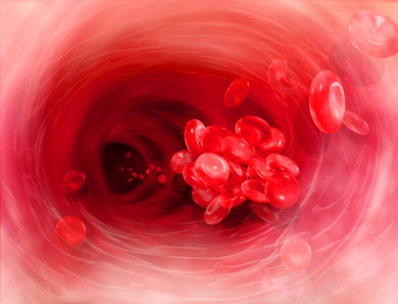
Prevention & treatment of PE
Prevention Chart 23-9
Exercises prevent venous stasis
Early ambulation
Anticoagulant
SCD
Treatment
Improve resp/cardio status
Anticoagulation
Thrombolytics
Surgery

Slide 72
Pause Point

Slide 73
A patient with a massive pulmonary embolism will have an ABG analysis performed to determine the extent of hypoxia. The acid-base disorder that may be present is:
A. Metabolic acidosis.
B. Metabolic alkalosis.
C. Respiratory Acidosis.
D. Respiratory Alkalosis.
Notes:
D. The patient with a massive PE will have a large region of lung unavailable for perfusion. This causes the patient to hyperventilate and blow off CO2, which crosses the unaffected side more readily.

Slide 74
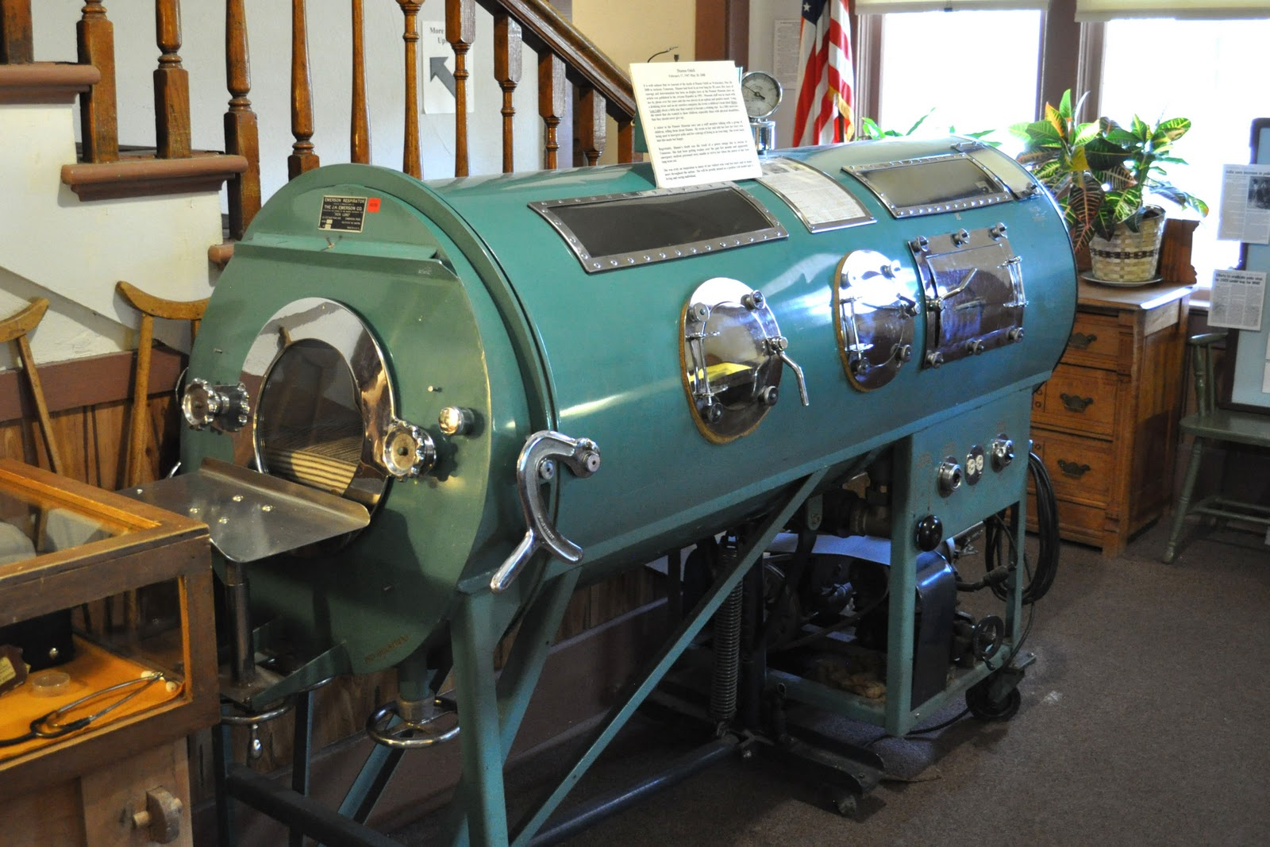
Notes:
Resp Part 3
Iron lung
Changed pressures around body to force to breathe

Slide 75
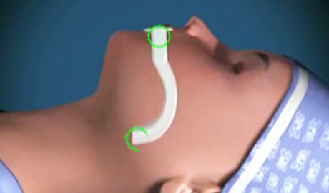
Airways
Oral
Nasal trumpet
Endotracheal tubes (ETT)
Tracheostomy tubes (Trach)

Slide 76
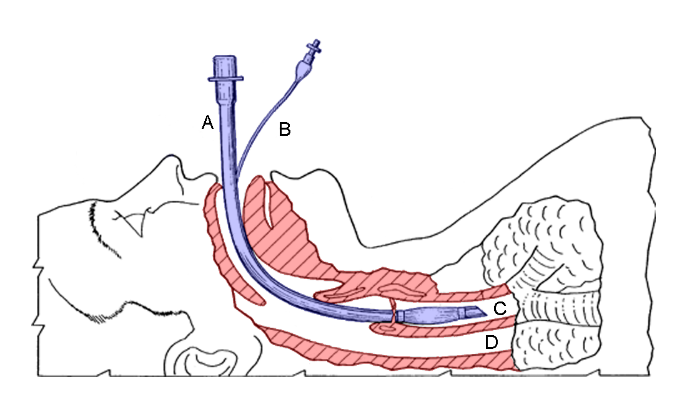
Endotracheal intubation
Placement of airway for mechanical ventilation
Removal of secretions
Purpose/complications tube cuff
Assessment cuff pressure
Chart 25-7 and 25-8
Patient assessment
Risk for injury/airway compromise R/T tube removal
Patient and family teaching
Notes:
CLICK for sketch

Slide 77
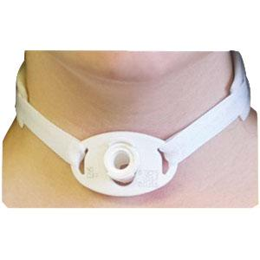
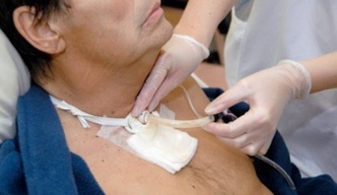
Tracheostomy chart 25-9
Bypasses upper airway
Long term airway
Complications
Bleeding
Pneumo
Aspiration
SQ Emphysema
Nerve damage
Long term problems
Airway obstruction
Infection
Ischemia
Notes:
Students have complete

Slide 78
Definitions
Sensitivity-inspiratory force
Tidal volume-10-15 ml/kg/min
Rate
Peak flow
High and low pressure limits
Pressure gauge
Spirometer
FIO2=oxygen %

Slide 79
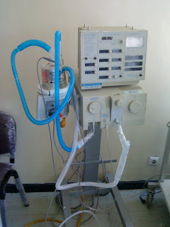
Mechanical ventilation
Positive or negative pressure breathing device
Maintain ventilation or oxygenation
Indications-chart 25-11
Negative pressure
“iron lung” chest cuirass
Positive pressure
Pressure cycled
Time cycled
Volume cycled
Notes:
CLICK for pic of old vent with bellow

Slide 80
Volume cycled ventilator
4 functions
Takes over work of breathing
Fixed volume of air
Limits peak pressures
Forces exerted on patient’s airway
Allows periodic sighs

Slide 81
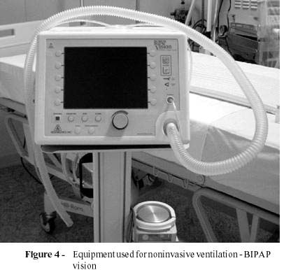
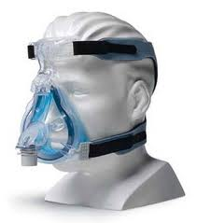
Non-invasive pos. press. ventilation
Mask or device maintain seal, permit ventilation
Indications
CPAP
BiPAP

Slide 82
Volume modes
Controlled (CMV, PRVC)
Preset volume at preset rate, spontaneous effort locked out
Assist controlled
Preset volume at preset rate, patient may trigger breath, negative inspiratory effort

Slide 83
Volume modes
SIMV
Preset min number of breaths synchronously delivered
Patient may take own breaths with variable volumes

Slide 84
Volume modes
CPAP
Spontaneous ventilation with positive airway pressure
Pressure Support (PS)
Pressure assistance with each spontaneous breath

Slide 85
Volume modes
PEEP
Airway pressure not allowed to turn to zero

Slide 86
Pause Point

Slide 87
How does PEEP improve oxygenation?
A. It provides more oxygen to the patient.
B. It opens up bronchioles and allows oxygen to get in the lungs.
C. It opens up collapsed alveoli and helps keep them open.
D. It adds pressure to the lung tissue, which improves gas exchange.
Notes:
C.

Slide 88
Nursing Process: Assessment
Head to toe assessment
In depth respiratory assessment
Comfort
Coping, emotional needs
Communication
Troubleshooting problems
Table 25-2

Slide 89
Nursing process: Diagnosis
Impaired gas exchange
Ineffective airway clearance
Risk for trauma
Impaired physical mobility
Impaired verbal communication
Defensive coping
Powerlessness

Slide 90
Nursing process: Collaborative pblm
Alterations in cardiac function
Barotrauma
Pulmonary infection
sepsis

Slide 91
Nursing process: Planning
Goals:
Optimal gas exchange
Maintenance patent airway
Optimal mobility
Absence of trauma or infection
Adjustment to nonverbal communication
Acquisition of successful coping measures
Absence of complications

Slide 92
Nursing process: Interventions
Impaired Gas Exchange
Assess ABG
Auscultate lung sounds
Judicious use analgesics
Fluid balance

Slide 93
Nursing process: Interventions
Impaired Airway Clearance
Assess lung sounds every 2-4 hours
Clear airway
Suction
CPT
Positioning
Mobility
Humidification
Medications

Slide 94
Nursing process: Interventions
Risk for Trauma and Infection
Infection control measures
Tube care
Cuff management
Oral care
Elevation HOB
Ventilator Associated Pneumonia (VAP) or VAE
PUD
DVT
Oral care Q2
Turn Q2
HOB 30

Slide 95
Nursing process: Interventions
ROM & mobility: OOB
Communication methods
Stress reduction
Promote coping
Family teaching
Family support
Home vent care
Chart 25-14 and 25-15

Slide 96
Documentation
Type of airway
Type of vent
Mode and vent settings
Lung sounds
ABG results/pulse ox
ETT size and lip line
Trach size
VAP protocol

Slide 97
Suctioning
Catheter size appropriate
Explain procedure
Pre-oxygenate 100%
Hyperventilate-manual with ambu bag
(if mucous plug)
Use 80-120 mmHg

Slide 98
Suctioning
10-15 seconds
Reposition ETT Q24 hours
Trach care Q shift & prn
Oral care
Brush teeth chlorhexadine Q12 hours
Alternate alcohol free & mint Q2

Slide 99
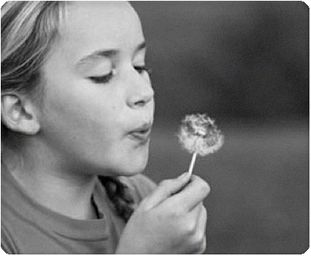
Weaning
Withdrawal of vent dependence
Collaborative
Criteria
Patient prep
Methods
Chart 25-16

Slide 100
I’m ready for a Nap!

